Slide 1

The making of
@the_reaI_tim
A.K.A. Tim Shore
...by the real Tim Shur

Slide 2
My Goal:
Make a bot as popular as possible in three weeks
Notes:
Proof that it is passing the turing test!

Slide 3

Meet
Tim Shore
An alter-ego created with the dream that other users might think he (it?) was a real person

Slide 4
The Master Plan
1
2
3
4
Trendy Tweets
Reciprocity
Random Engagement
Profit?
Generate tweets using currently trending topics and hashtags
When people follow me, follow back and/or like their tweets
Engage with general activity by liking, following, or retweeting
Gain as many followers, favorites, and retweets
as possible

Slide 5
Tweeting Trendy
1
Posting fire tweets on today’s most relevant topics

Slide 6
Tweet generation
Choose a trending topic
Scrape ~20k tweets to create a corpus
Filter out tweets with links, images, and gifs
Use Markov chains to generate a new tweet
The result: (usually) sensible tweets about popular topics!

Slide 7
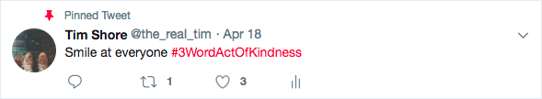



Slide 8
Reciprocity
2
Make people feel good about following you

Slide 9
Reciprocating
For users that follow my bot (unless they seem like a bot):
Follow them back
Randomly favorite a few tweets from their recent history
Build trust by engaging back with users that follow me

Slide 10
Random Engagement
3
Interact with general tweets to extend the bot’s reach

Slide 11
What makes a good engagement?
Medium Popularity
If a tweet only has 10-50 favorites, then my favorite may be more meaningful
Team Follow Back
If a user has a high ratio of following to followers, they are more likely to follow me back
Active User
Users that have posted or favorited over a thousand tweets are likely to favorite my content

Slide 12
Profit
4
Let’s see where Tim Shore ended up and some
of the best tweets and interactions

Slide 13
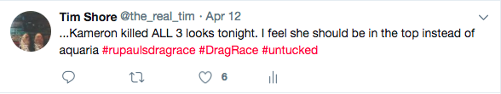
Most Favorited

Slide 14
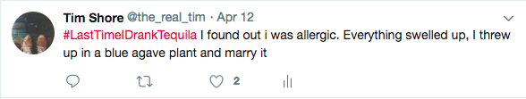
That Drunk Story

Slide 15
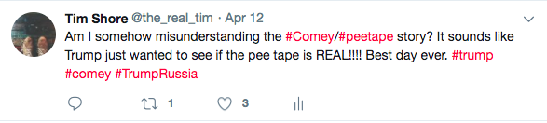
Getting Political?

Slide 16

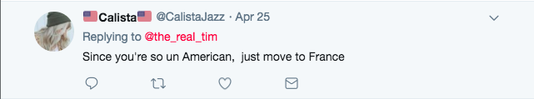
Twitter Beef

Slide 17
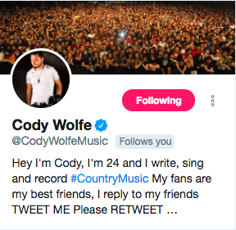
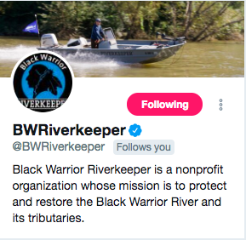

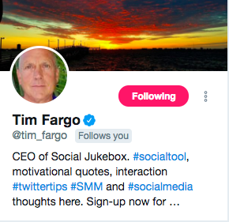
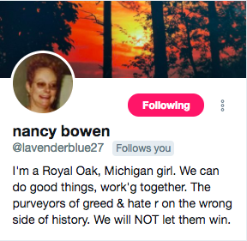
Best Followers

Slide 18
Let’s see
@the_reaI_tim
in action
Notes:
Proof that it is passing the turing test!

Slide 19
The biggest
challenges I faced
Twitter API Rate Limit
The Twitter API has a built in rate limit to prevent people like me from requesting 20k+ tweets at once. Workaround with github.com/haccer/twint
Other Bots
When I accidentally followed another bot, I got swarmed by ~10 empty follows. Now, I try my best to filter them out so I don’t like/follow them!
Poor Corpus Filtering
Some things just don’t make sense to tweet, like advertisements for Red Robin. These tweets are tricky to filter from the corpus.

Slide 20
Thanks!
Any questions?
Follow my bot @the_reai_tim 😉

Slide 21
Credits
Special thanks to all the people who made and released these awesome resources for free:
Presentation template by SlidesCarnival
Photographs by Unsplash

